Slide 1
Assignment #9 IE5351 Introduction to Systems Engineering
Team II Members
Noran Abulaila (noran.abulaila@mavs.uta.edu)
Lekhya Sindura Nadella (lxn8999@mavs.uta.edu) (Point of Contact)
Gopal Penmetsa (gkp8869@mavs.uta.edu)

Slide 2
Assignment Tasks
Part I: SysML
Getting familiar with software application / tools that facilitate the creation of SysML models.
Part II: Package Diagram
Develop a top-level package diagram to organize model elements for a food delivery drone system that is used by a nearby restaurant for deliveries in multi-story apartments.
Create at least 2 lower-level package diagram to organize other aspects of the model that relate to this top-level package.
Provide your team’s rationale for this method of organizing the packages.
Getting familiar with software application / tools which facilitate the creation of SysML models.
01

Slide 3
SysML
Part I
02

Slide 4
SysML
Systems Modelling Language (SysML) is a general-purpose graphical modelling language for specifying, analysing, designing, and verifying complex systems that may include hardware, software, information, personnel, procedures, and facilities. In particular, the language provides graphical representations with a semantic foundation for modelling system requirements, behaviour, structure, and parametrics, which is used to integrate with other engineering analysis models (OMG SysML, 2003).
SysML reuses a subset of UML 2 and provides additional extensions to satisfy the requirements of the language. This International Standard documents the language architecture in terms of the parts of UML 2 that are reused and the extensions to UML 2 (ISO/IEC 19514:2017, 2022).
03

Slide 5
Catia MagicDraw + SysML plugin
There are various software applications available to facilitate the creation of SysML models. We chose to use the Catia MagicDraw software with SysML plugin to facilitate the creation of package diagram for this assignment.
We installed demo version of MagicDraw 19.0 SP4 LTR enterprise edition and then installed the SysML plugin from the Dassault.
Created a new project with systems engineer perspective, and created the structure and package diagram for the Food Delivery Drone system.
04

Slide 6
Package Diagram
Part II
05

Slide 7
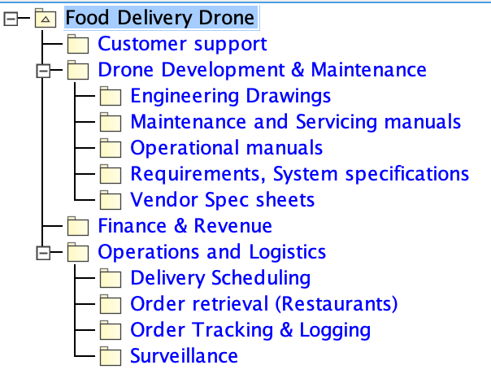
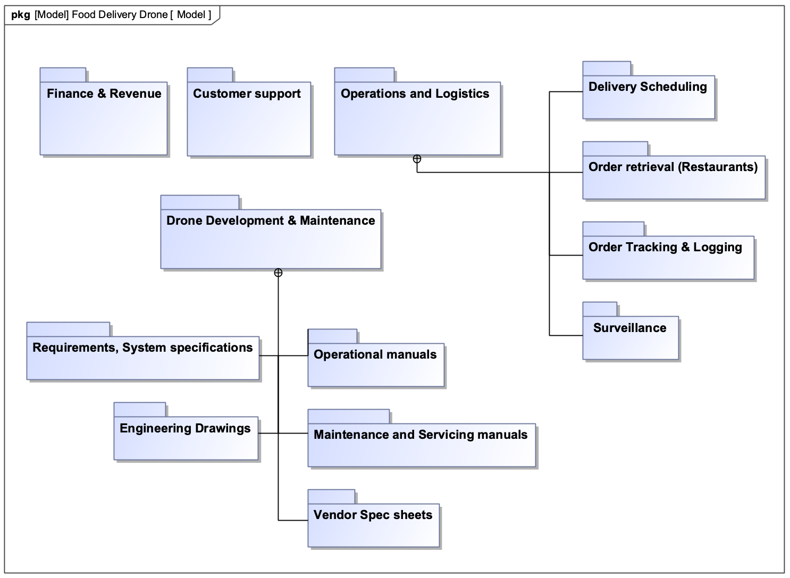
Top-Level Package Diagram
06

Slide 8
Top-Level Package Diagram
We have 4 packages at the top-level of the package diagram.
Operations and Logistics
This package encapsulates all the elements concerned to the food delivery operations and logistics.
Drone Development & Maintenance
This package encapsulates all the elements concerned to the food delivery drone (i.e, specification and requirements, operational manuals and other documents related to the drone itself.)
Finance & Revenue
This package encapsulate all the elements concerned with finances of the system.
Customer support
This package encapsulate all the elements concerned to customer who order food through our system.
07

Slide 9
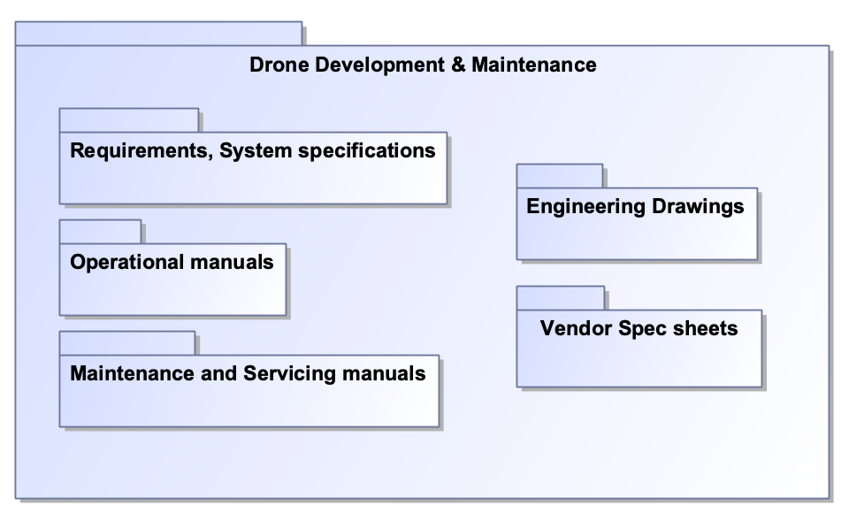
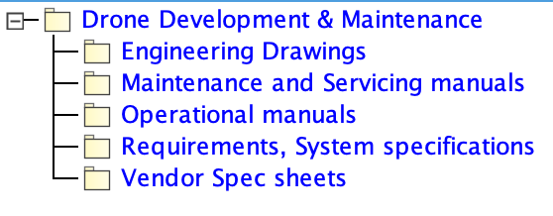
Lower-Level Package Diagram
08

Slide 10
Lower-Level Package Diagram
We have 5 packages nested within the Drone Development & Maintenance package.
Requirements, System specifications
This package encapsulates all the requirement, specification documents related to the drone.
Engineering Drawings
This package encapsulates electrical, mechanical and other drawings of the drone.
Vendor Spec sheets
This package encapsulates the specification and other documents related to the 3rd party vendor through whom we source the parts or components of our drone.
Maintenance and Servicing manuals
This package encapsulates the manuals required to perform maintenance and provide service to our fleet of drones.
Operational manuals
This package encapsulates the manuals required to operate the drone for the food delivery operation.
09

Slide 11
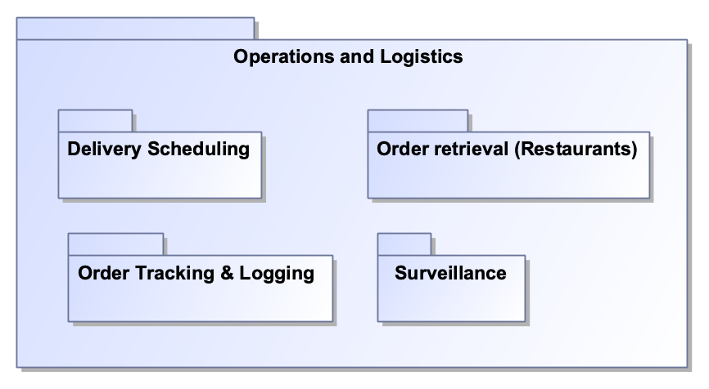
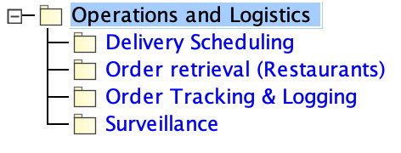
Lower-Level Package Diagram
10

Slide 12
Lower-Level Package Diagram
We have 4 packages nested within the Operations & Logistics package.
Order Tracking & Logging
This package encapsulates the information regarding the order tracking and the data logged about the user for future use.
Delivery Scheduling
This package encapsulates the elements concerned with the delivery scheduling system.
Order retrieval (Restaurants)
This package encapsulates the information related to the restaurants from whom we source the food that’s begin delivered.
Surveillance (God-View)
This package encapsulates the elements related to the surveillance system used to monitor our drone fleet in real-time.
11

Slide 13
Package-Organization Rationale
Our reasoning behind choosing the above organizing method comes from a team-based approach.
All Documents are organised based on the Team responsible maintaining or updating the said document.
We identified 4 primary groups for the food delivery drone project:
Operations and Logistics
Drone Development & Maintenance
Finance & Revenue
Customer support
12

Slide 14
References
What is SysML? What is SysML? | OMG SysML. (n.d.). Retrieved November 21, 2022, from https://www.omgsysml.org/what-is-sysml.html
ISO/IEC 19514:2017. ISO. (2022, September 3). Retrieved November 21, 2022, from https://www.iso.org/standard/65231.html
13

